Slide 1
SMARTPHONE TECHNOLOGY; APPLE, SAMSUNG, AND NOKIA
By Kairatbekuly Umbet
Muratbek Amangul

Slide 2
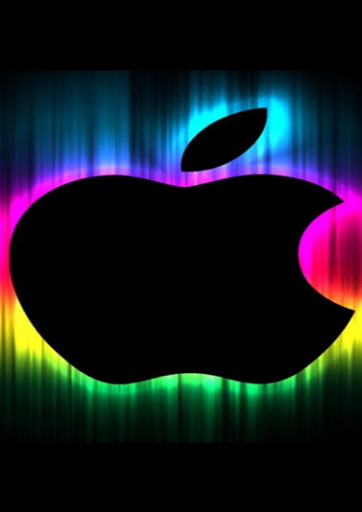
iPhone
The iPhone is a series of smartphones made by Apple Inc since 2007. It does many things that a computer can do, but is small enough to fit in someone's hand. It is a mobile phone, meaning that it makes calls and sends text messages but without wires. There're many types of iPhones, such as the model iPhone X.
The iPhone can access the Internet as well, either using a cellular network or over Wi-Fi. Like an iPod, it plays music and videos that have been downloaded from the Internet directly, or which have been put on it by connecting it to a personal computer, which is called syncing. It also has a calendar and 1, 2 or 3 built-in cameras. A user can make it do many other things, such as run video games, by downloading apps from the App Store.
The iPhone doesn't have as many buttons as other well-known phones in the early days, such as those made by companies like Motorola and Nokia. Instead, it had a touch screen that covers much of the front of the phone. People control the phone by touching things that appear on the screen with a finger or two. This technology is called multi-touch, and involves tapping, dragging, and even typing on a keyboard picture shown on the screen.
All iPhones run on a mobile operating system which Apple calls "iOS". A new version of iOS comes out every year, each having more features than the one before. Each new iPhone comes with the latest version of iOS, and older iPhones usually also get a software update to the latest version. The more-recent iPhones, such as the iPhone 13 and variants of it, use iOS 15 and came out in September 2021.
As of November 1, 2018, more than 2.2 billion iPhones had been sold.

Slide 3
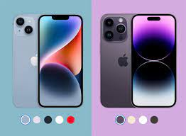
Historical information
The iPhone 6 and iPhone 6 Plus were released on September 19, 2014. They both have bigger screens than the iPhone 5, measuring at 4.7 inches and 5.5 inches, respectively. The iPhone 6S and iPhone 6S Plus were released on September 25, 2015. They both come in a new color, Rose Gold.
The iPhone 7 and iPhone 7 Plus were released on September 16, 2016.
The iPhone 8, 8 Plus, and X were released in 2017 respectively.
The iPhone XR, XS, and XS Max were released in 2018 respectively.
The iPhone 11, 11 Pro, and 11 Pro Max were released in 2019 respectively.
The iPhone SE (2nd gen), 12 mini, 12, 12 Pro and 12 Pro Max were released in 2020 respectively.
The iPhone 13 mini, 13, 13 Pro and 13 Pro Max were released in 2021 respectively.
The iPhone SE (3rd gen), 14, 14 Plus, 14 Pro and 14 Pro Max were released in 2022 respectively.

Slide 4
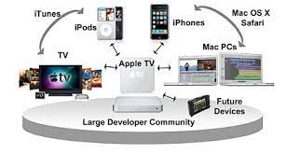
apple ecosystem
Apple's various networks and platforms of interactive hardware and devices are described as an ecosystem due to how seamlessly they simultaneously function together with and take advantage of each other.Apple products often come with extra features when paired with other Apple products, as opposed to alternatives.Privacy is also considered a major perk of the ecosystem, as Apple markets its products with high standards of privacy, sometimes using it as a selling point over competitors."Walled garden"
Apple's ecosystem is often described as a walled garden.While peripherals such as AirPods, HomePods and AirTags integrate complementarily into the ecosystem, with products such as the iPhone, it does not function as well or with as many features with competitive devices such as Android smartphones.Also, it is not easy to switch from the ecosystem once users have immersed themselves into it, as it is designed to keep users from leaving.

Slide 5
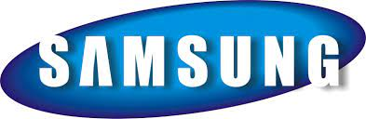
samsung
The Samsung Group[3] (or simply Samsung, stylized as SΛMSUNG) is a South Korean multinational manufacturing conglomerate headquartered in Samsung Town, Seoul, South Korea. It comprises numerous affiliated businesses, most of them united under the Samsung brand, and is the largest South Korean chaebol (business conglomerate). As of 2020, Samsung has the 8th highest global brand value.
Samsung was founded by Lee Byung-chul in 1938 as a trading company. Over the next three decades, the group diversified into areas including food processing, textiles, insurance, securities, and retail. Samsung entered the electronics industry in the late 1960s and the construction and shipbuilding industries in the mid-1970s; these areas would drive its subsequent growth. Following Lee's death in 1987, Samsung was separated into five business groups – Samsung Group, Shinsegae Group, CJ Group and Hansol Group, and Joongang Group.
Notable Samsung industrial affiliates include Samsung Electronics (the world's largest information technology company, consumer electronics maker and chipmaker measured by 2017 revenues), Samsung Heavy Industries (the world's 2nd largest shipbuilder measured by 2010 revenues), and Samsung Engineering and Samsung C&T Corporation (respectively the world's 13th and 36th largest construction companies).Other notable subsidiaries include Samsung Life Insurance (the world's 14th largest life insurance company), Samsung Everland (operator of Everland Resort, the oldest theme park in South Korea) and Cheil Worldwide (the world's 15th largest advertising agency, as measured by 2012 revenues).

Slide 6
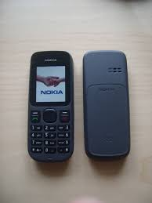
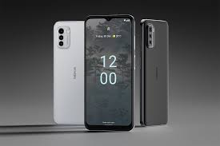
Nokia
Nokia Corporation (natively Nokia Oyj, referred to as Nokia; stylized as NOKIA)[a] is a Finnish multinational telecommunications, information technology, and consumer electronics corporation, established in 1865. Nokia's main headquarters are in Espoo, Finland, in the greater Helsinki metropolitan area, but the company's actual roots are in the Tampere region of Pirkanmaa. In 2020, Nokia employed approximately 92,000 people[6] across over 100 countries, did business in more than 130 countries, and reported annual revenues of around €23 billion.[4] Nokia is a public limited company listed on the Helsinki Stock Exchange and New York Stock Exchange.It is the world's 415th-largest company measured by 2016 revenues according to the Fortune Global 500, having peaked at 85th place in 2009.[8] It is a component of the Euro Stoxx 50 stock market index.The company has operated in various industries over the past 150 years. It was founded as a pulp mill and had long been associated with rubber and cables, but since the 1990s has focused on large-scale telecommunications infrastructure, technology development, and licensing. Nokia made significant contributions to the mobile telephony industry, assisting in the development of the GSM, 3G, and LTE standards. For a decade beginning in 1998, Nokia was the largest worldwide vendor of mobile phones and smartphones. In the later 2000s, however, Nokia suffered from a series of poor management decisions, and soon saw its share of the mobile phone market drop sharply. After a partnership with Microsoft and Nokia's subsequent market struggles, Microsoft bought its mobile phone business,creating Microsoft Mobile as its successor in 2014.After the sale, Nokia began to focus more on its telecommunications infrastructure business and on Internet of things technologies, marked by the divestiture of its Here mapping division and the acquisition of Alcatel-Lucent, including its Bell Labs research organizationThe company then also experimented with virtual reality and digital health, the latter through the purchase of Withings.The Nokia brand returned to the mobile and smartphone market in 2016 through a licensing arrangement with HMD Global. Nokia continues to be a major patent licensor for most large mobile phone vendors.As of 2018, Nokia is the world's third-largest network equipment manufacturer.

Slide 7
How Apple iPhone differs from Android smartphones
very good - Apple has put a lot of time and effort into improving it. Apple devices offer a convenient, comfortable and intuitive interface, however, Android gadgets are also very easy to use and do not cause difficulties. We can say that the described operating systems have a different, but equally clear menu. Smartphones on Android are more suitable for users who like to Independently, solely at their own discretion, customize their device by changing the design.
An important difference between the platforms lies in the ecosystem to which the end consumer is tied. For Android, these are Google services and other large-scale systems, while the iPhone has several cloud services and most often calls for contact exclusively with devices of their own brand, creating an intuitive synchronization between them.
both platforms have their own stores: Android - Google Play, iPhone - App Store, offering various programs to their consumers.
Android smartphones are a universal open system adapted to devices with a wide variety of fillings that are easy to hack, copy and reinstall. iPhones are based on a closed source system, which means that the unique characteristics of smartphones are fully protected by Apple patents. The system cannot be downloaded, it is almost impossible to hack and adapt. Therefore, this operating system has increased stability, updates are released for almost identical smartphones with very similar filling, supported only by Apple products: iPhone, iPad, iPod Touch, AppleTV.

Slide 8


